Slide 1

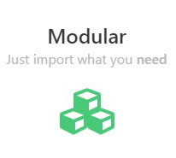

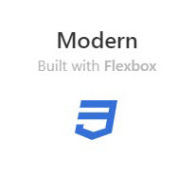


An Overview of Bulma Framework
What is Bulma?
Bulma is a Free, Modular, Responsive CSS framework based on Flexbox

Slide 2
Why Choose
?

Slide 3

Modern features
By using the latest CSS3 features such as Flexbox, and planning on using CSS Variables and CSS Grid, Bulma aims to stay on the bleeding edge of browser technology

Slide 4


Simple grid system
To build a Bulma grid, you only need a single .columns container to wrap as many .column items as you want

Slide 5
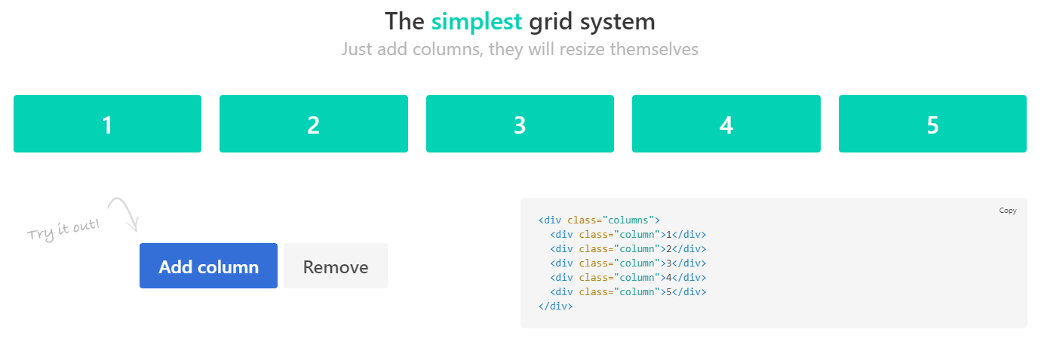

Slide 6

Easy-to-learn syntax
With simple readable class names like .button or .title, and a straightforward modifiers system like .is-primary or .is-large, it’s easy to pick up Bulma in minutes

Slide 7
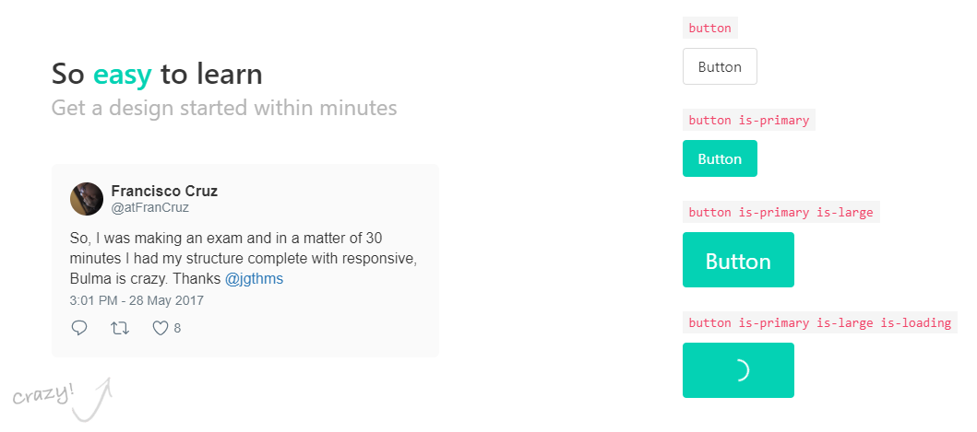

Slide 8

Font Awesome 5 support
Bulma is compatible with both Font Awesome 4 and Font Awesome 5 thanks to the .icon element

Slide 9

100+ useful CSS helpers
Bulma ships with more than 100 helpers to specify color, display, and spacing.
Responsive helpers – Typography helpers – Other helpers

Slide 10


No JavaScript
By focusing only on CSS, Bulma provides a lightweight solution that can easily be implemented in any development context

Slide 11

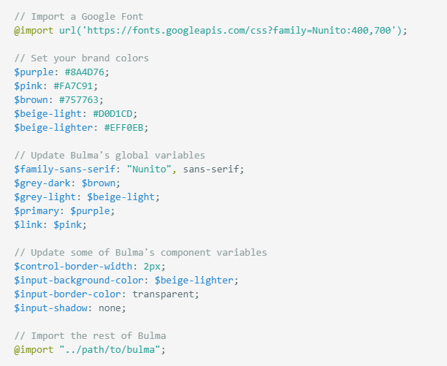
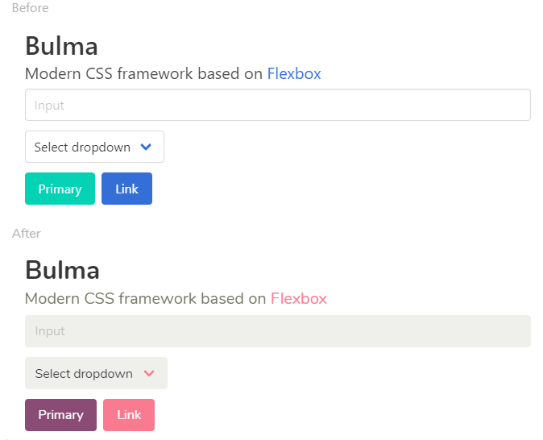
So quick to customize
Simply set your own Sass variables before importing Bulma

Slide 12


Slide 13
